Slide 1
Considerations for siting your business
Sarah Schelling, AICP, Senior Planner, City of Lacey

Slide 2
Sarah Schelling, AICP, Senior Planner, City of Lacey
Works with Property owners seeking to develop or redevelop their property
Works with citizens on land use issues
Serves as subject matter expert for citizens, elected officials, and staff
Works with businesses to ensure that the site they’re considering will work for them
Zoning
Land Use
Site development and design

Slide 3
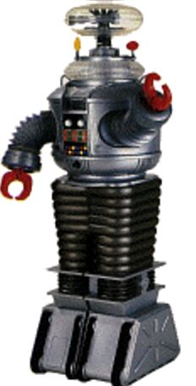
Warning, Warning! Danger, Danger!
Do NOT execute a lease or purchase agreement until you determine that the site that you’re considering is
Viable
Zoning permits your type of business
Your business will fit
Cost of any required modifications are within your budget!

Slide 4
But how do you know ???
Contact a friendly, knowledgeable, and helpful Planner…

Slide 5
What Planners do to help businesses once they have a site in mind
Answer questions of Zoning and Use
Listen and talk through potential issues and solutions
FREE presubmission conference

Slide 6
What zones work with my business?
Depends on desired location and type of business
Commercial districts are located throughout the City
Found a site? check in with the City to verify zoning compatibility and next steps

Slide 7
Where to locate?
Woodland District
(High design standards for new construction)
Central Business Districts
Zones are appropriate for
Small and large scale retail and commercial operations
Professional and personal services
Restaurants, recreation, and entertainment
Some light warehousing and manufacturing in limited locations
Central Lacey Area

Slide 8
Where to locate?
Hawks Prairie Business District
General Commercial District
Mixed Use High Density Corridor
Light industrial zoning
Community and Neighborhood Commercial Zone
Zones are appropriate for
Small and large scale retail and commercial operations
Professional and personal services
Restaurants, recreation, and entertainment
Light industrial activities (manufacturing, warehousing, distribution in zones north of Interstate 5)
Neighborhood and Community Commercial zones are for uses compatible with residential
Hawks Prairie Area

Slide 9
Where to locate?
Community Commercial
Community Office
Zones are appropriate for
Smaller scale retail and commercial operations
Professional and personal services
Restaurants
Uses compatible and complementary to nearby residential
South Lacey – College and Yelm Highway Area

Slide 10
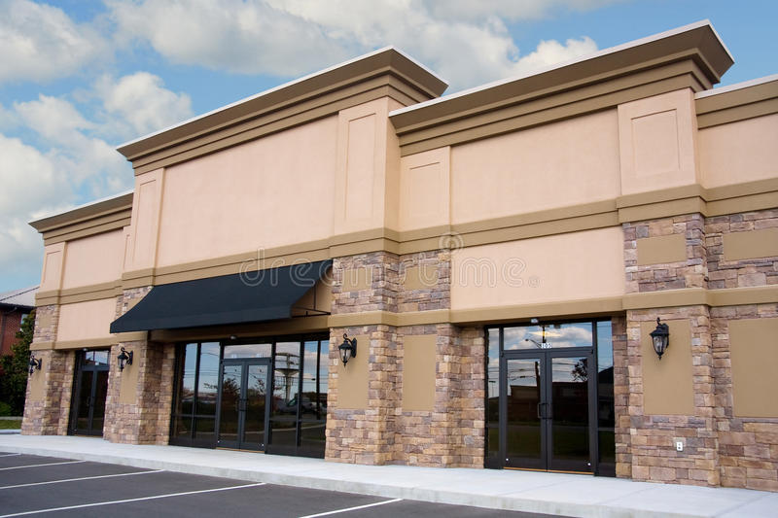
What type of Space?
Storefront
Street merchant
Home occupation

Slide 11
Storefront
Verify zoning district is appropriate for use
Existing building or new building
Tenant Improvement vs. site plan review(land use approval)
Presubmission conference
Required for some permit applications
Free! (at the City of Lacey – other jurisdictions may charge a fee)

Slide 12
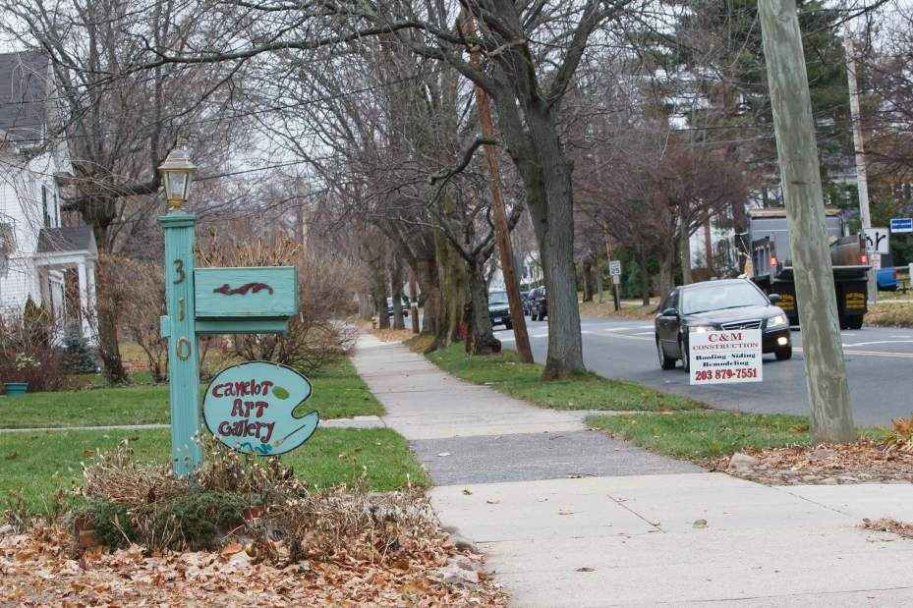
Home Occupations
Considering a home occupation until a storefront comes available?
Know the City regulations surrounding home occupations
Size limitations
Staff restrictions
Signage limitations
Parking requirements
Qualifying businesses

Slide 13
Home Occupations con’t.
Opportunity to use your home as a place of livelihood for provided certain criteria can be met:
twenty-five percent of the total floor area of the residence and no more than four hundred square feet.
no noise, air pollutants, waste products or other effects detrimental to the environment or the neighborhood

Slide 14
Street Merchants
Considering opening up a food truck or other mobile business?
Again… know the City regulations
Location restrictions
Design standards
Signage standards
Visit the Planning Department of your local jurisdiction to have your questions answered

Slide 15
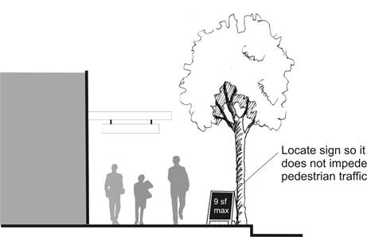
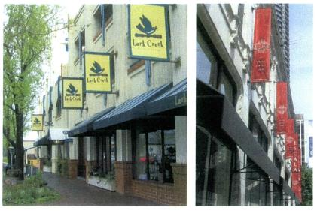
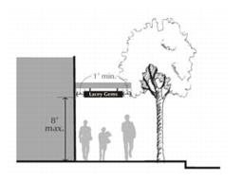
Other regulatory considerations…
Signage know what is permitted and what is not when considering a location (especially if the location is out of the way, or back from the roadway )

Slide 16
Commercial Sign Regulations
Wall signs
Determined by size of building or tenant space wall
Monument sign (or space on a monument)
Size dependent on parcel frontage (additional size for dark color and/or unique designs)
Temporary signs
Sandwich boards, banners, flags (permitted for certain uses or certain timeframes)

Slide 17
A Business License is Required!
https://dor.wa.gov/open-business/apply-business-license

Slide 18
Zoning and permitting resources
https://lacey.municipal.codes/LMC/16
(Title 16 of the Lacey Municipal Code – Zoning Chapters)
http://ci.lacey.wa.us/city-government/city-departments/community-and-economic-development/planning-zoning/zoning-map
(Link to interactive zoning map to check property zoning)
http://ci.lacey.wa.us/city-government/city-departments/community-and-economic-development/frequent-questions
Frequent questions related to permitting
http://www.ci.lacey.wa.us/city-government/city-departments/community-and-economic-development/sign-regulations/commercial-signs
Commercial sign information
http://www.ci.lacey.wa.us/city-government/city-departments/community-and-economic-development/sign-regulations/temporary-signs
Temporary sign information

Slide 19
What questions do you have?

Slide 20
We ARE here to help!
Sarah Schelling, AICP
Senior Planner
City of Lacey
sschelli@ci.lacey.wa.us
(360) 438-2689
Department of Community and Economic Development
(360)491-5642 (for general building permit and planning questions)
build@ci.lacey.wa.us
plan@ci.lacey.wa.us
https://www.locationlocationlacey.com/

